Slide 1

Small Web Project
Internship Evaluation

Slide 2
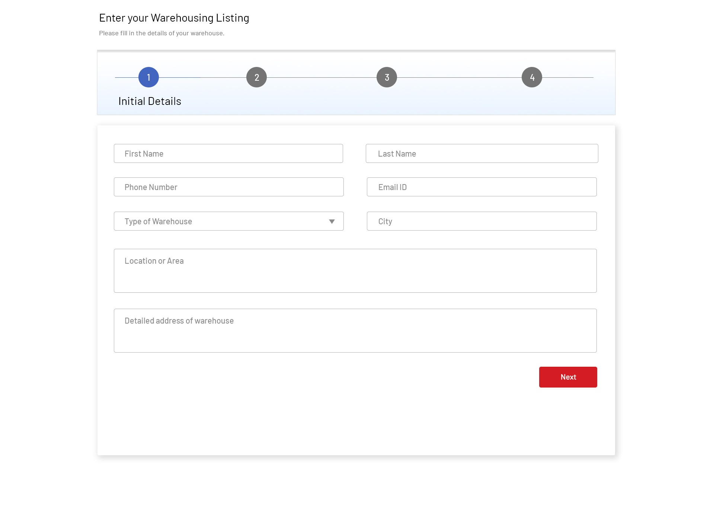
1
This web application comprises of a 4-step form through which users can submit details of their property (warehouse)
Date submitted by users should be recorded in a database.
First step is general information. Type of warehouse can be – Regular or Airconditioned
Clicking on Next button will save the info and take user to next screen

Slide 3
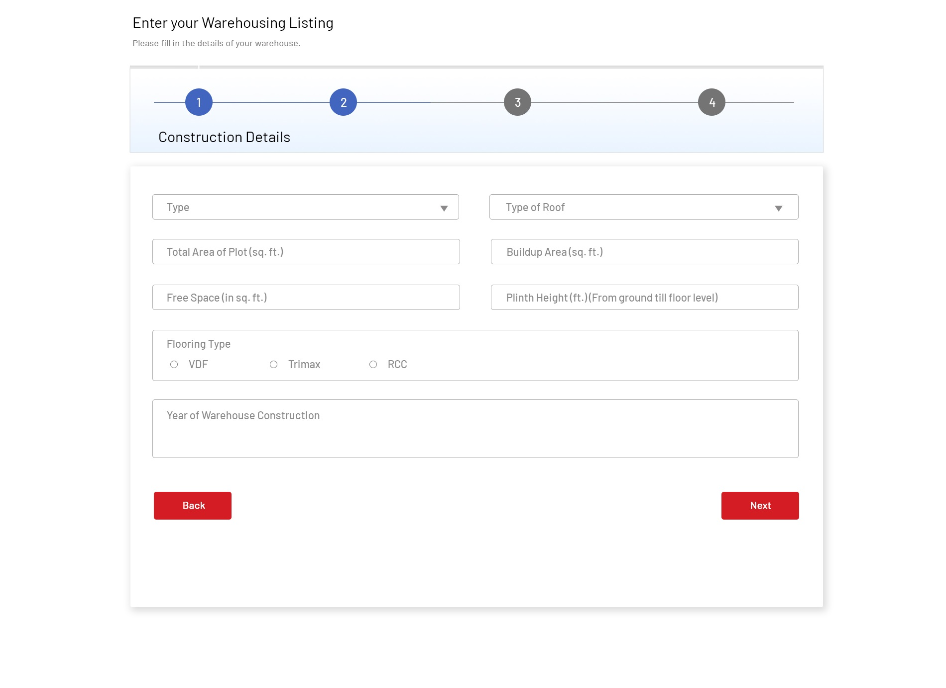
2
This is 2nd screen where the user will fill construction details of their warehouse.
On clicking Back button user must navigate to the previous screen and on clicking the Next button user should land to the next screen.

Slide 4
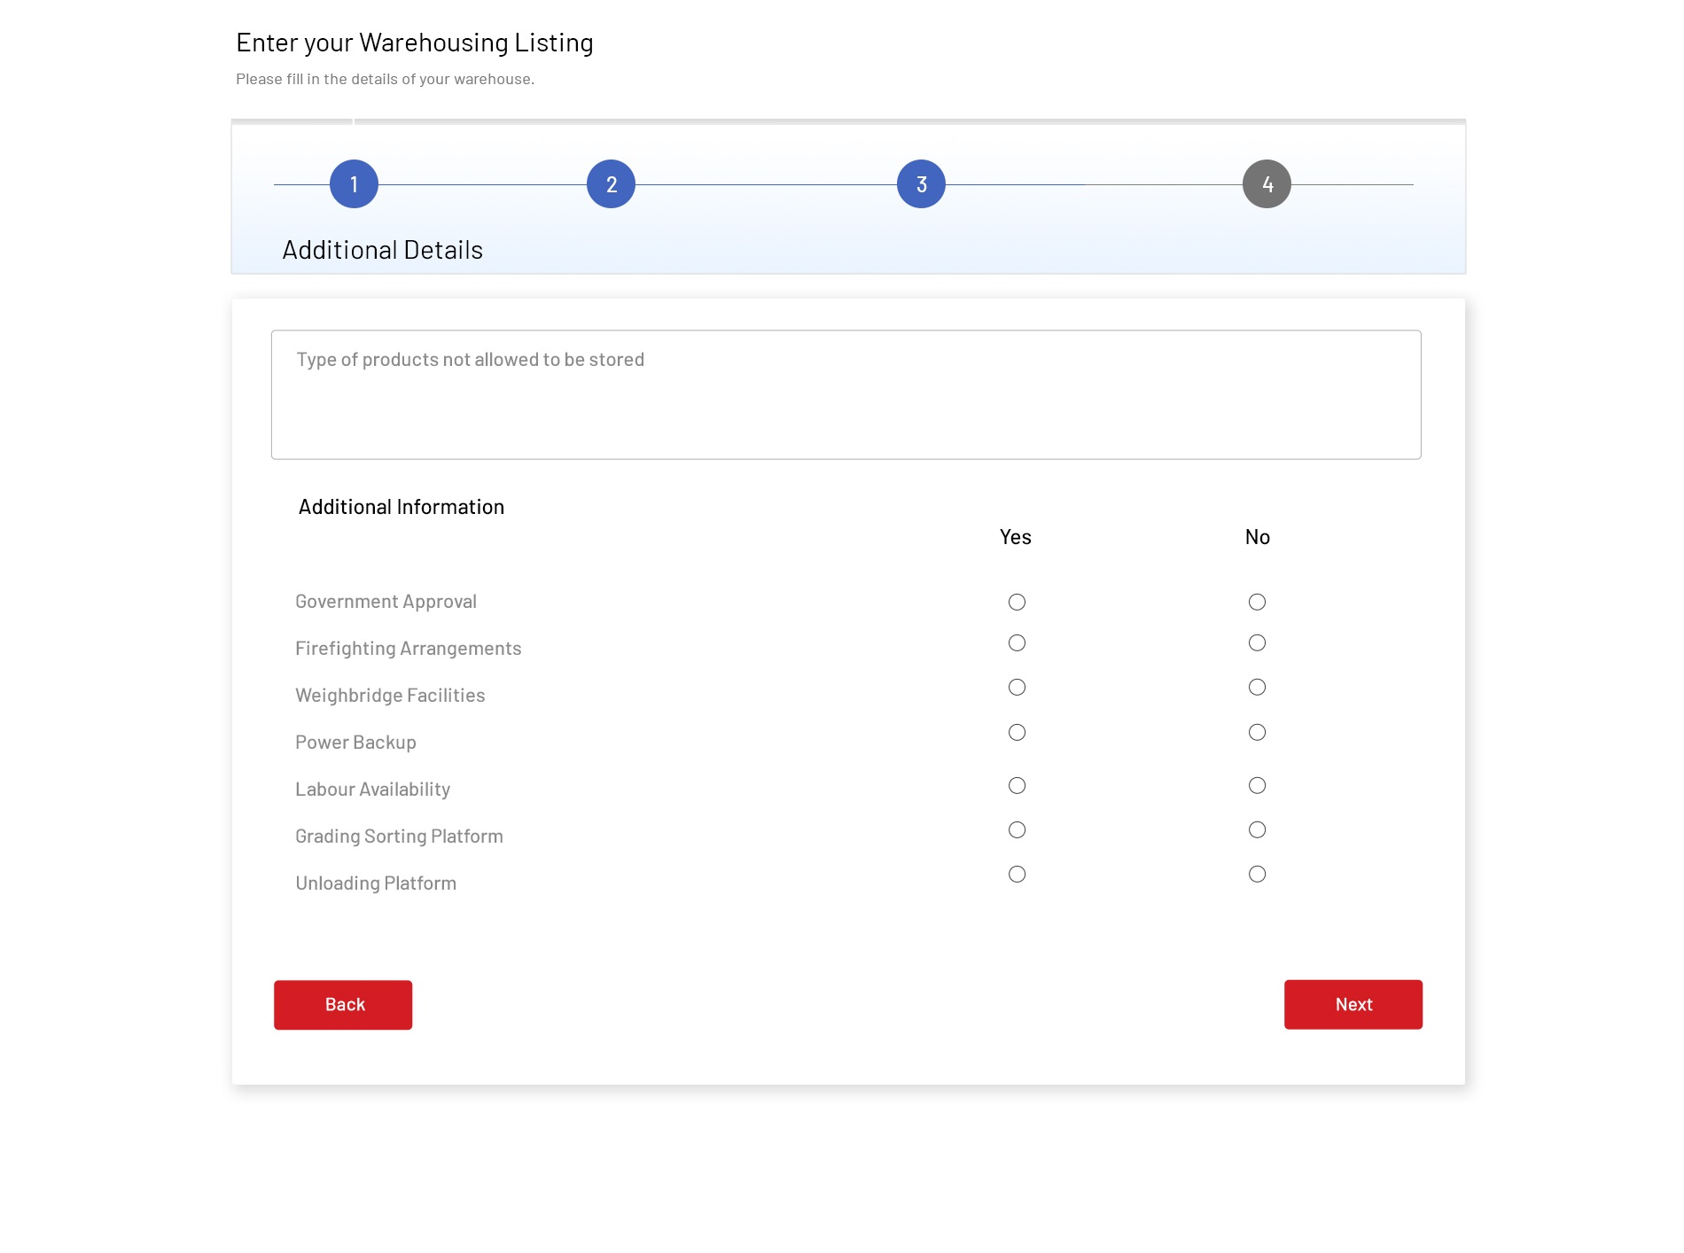
3
This is 3rd screen where the user will fill his/her Additional Details
Back and Next buttons must be active.
On clicking Back button user must navigate to the previous screen and on clicking the Next button user should land to the next screen.

Slide 5
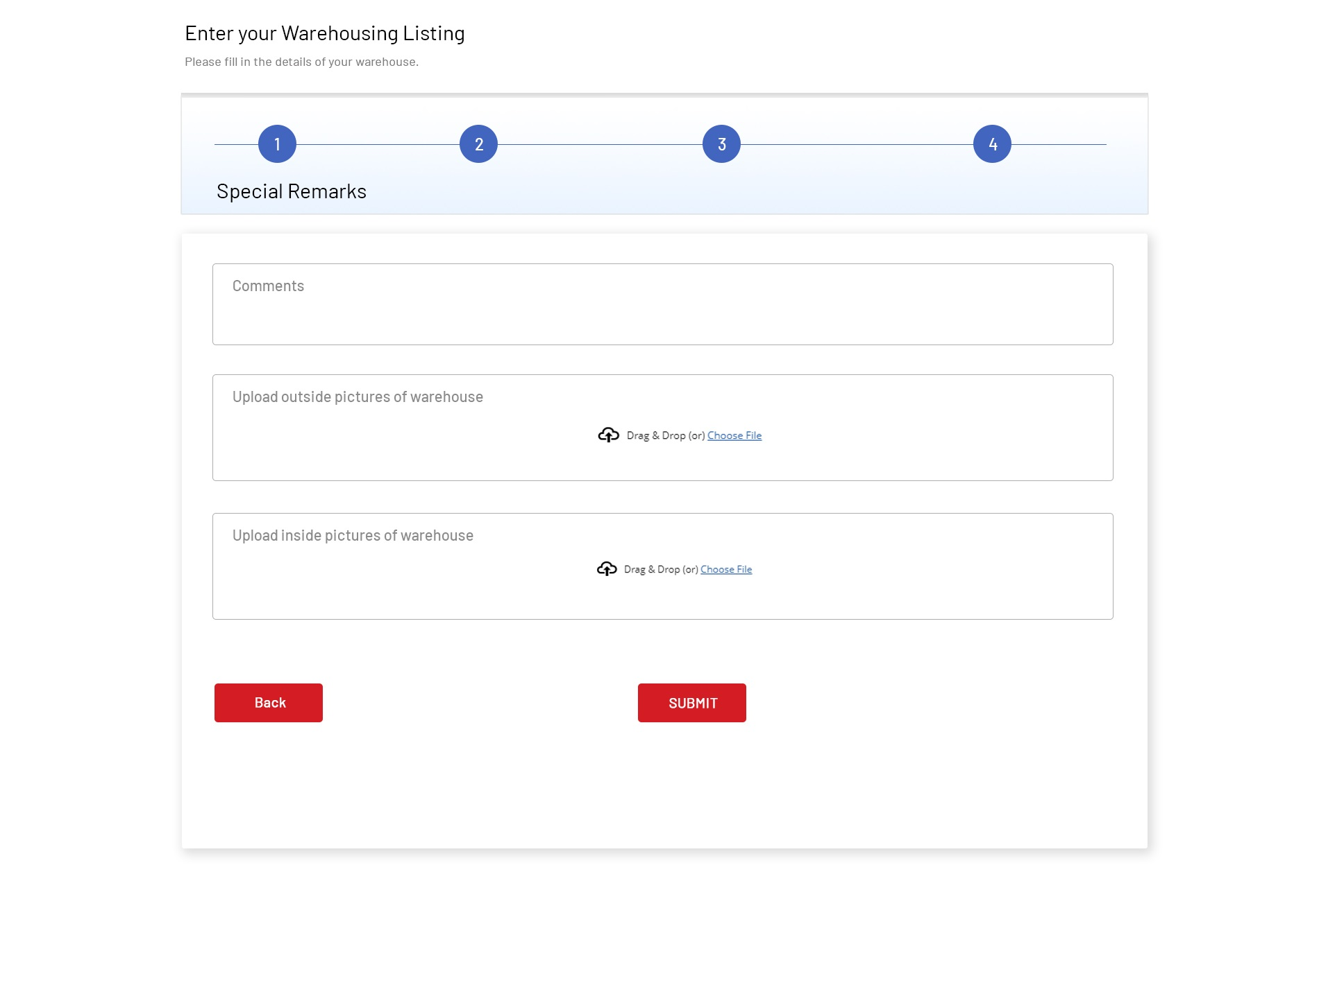
4
This is 4th screen where the user will fill his/her Special Remarks
Provision to upload files is to be built
On clicking Back button user must navigate to the previous screen and on clicking the Submit button user all data should be saved.

Slide 6
NOTES
You can develop app using any framework and database
Project submission last date is 15th July’21
Once the project is completed, please write a mail to
elina@acompworld.com mentioning the following:
1. Project framework/platform details
2. Your name, phone number, gmail ID, Anydesk ID.
We will then setup a call over Google Meet to review the project and conduct your interview.

